Slide 1
Presentation on bmi calculator
Submitted by : Pradeep KUMAR chaurasiya.
Submitted to: DR. A. Ranjith kumar

Slide 2
Table of content
Introduction
Scope of the project
Objective
Screenshot of output program
Result and conclusion

Slide 3
introduction
A BMI calculator is a tool used to determine if an individual's weight is within a healthy range for their height.
It is calculated by dividing a person's weight in kilograms by their height in meters square.
The resulting number is then used to categorize individuals into different BMI ranges, such as underweight, normal weight, overweight, and obese
While BMI can be a useful tool in assessing health risks associated with weight, it is important to note that it is not a perfect measure of health and should be used in conjunction with other factors, such as waist circumference and overall health.

Slide 4
Table and formula
BMI = Weight in Kilograms / (Height in Meters * Height in Meters)
BMI Range | Category
< 18.5 | Underweight
18.5 - 25 | Normal
25 - 30 | Overweight
> 30 | Obese

Slide 5
Scope of the project
A BMI calculator can be used by individuals to determine whether their weight falls within a healthy range based on their height.
It can be used as a screening tool by healthcare professionals to assess an individual's risk for certain health conditions associated with weight, such as diabetes, heart disease, and high blood pressure.
It can help individuals set realistic weight loss goals and track their progress over time.
It can be used to monitor the weight of individuals who are at risk for weight-related health problems, such as those with a family history of obesity or those who have recently undergone weight loss surgery.
It can serve as a starting point for discussions with healthcare professionals about weight management and overall health.

Slide 6
objective
It provide a quick and easy way for individuals to assess whether their weight is within a healthy range based on their height.
It help individuals identify potential health risks associated with being underweight, overweight, or obese.
It encourage individuals to adopt healthy lifestyle habits, such as regular exercise and a balanced diet, to improve their overall health and reduce their risk of chronic diseases.
It serve as a useful tool for healthcare professionals, such as doctors and nutritionists, in assessing the health status of their patients and developing appropriate treatment plans.
It raise awareness about the importance of maintaining a healthy weight and promoting a culture of health and wellness.

Slide 7
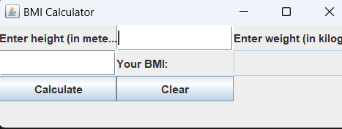
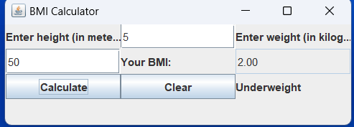
Screenshot of output

Slide 8
Result and conclusion of the project
BMI is a measure of body fat based on height and weight.
The formula to calculate BMI is weight (kg) / height (m)^2.
BMI can be used to screen for weight categories that may lead to health problems.
The weight status categories based on BMI are underweight, normal weight, overweight, and obesity.
BMI is not a diagnostic tool for specific health conditions and should be used in conjunction with guidance from a healthcare professional.
BMI doesn't account for differences in body composition, such as muscle mass versus fat mass.
Athletes, older adults, and others who have a higher muscle mass may have a higher BMI but may not necessarily be overweight or obese.
Overall, BMI can be a useful tool for assessing weight status and potential health risks associated with being overweight or obese, but it should be used in conjunction with other measures and with guidance from a healthcare professional.

Slide 9
Reference
Google and,
Youtube

